Slide 1
Hands-on Deucalion Ilyass Hankrir | ihankrir@ualg.pt Alexandre Gomes | ajgomes@ualg.pt HPCvLAB@UALGARVE 14 January 2026

Slide 2
Tools
If using a Microsoft Windows OS:
- MobaXTerm Home Edition (available from https://mobaxterm.mobatek.net/)

Slide 3
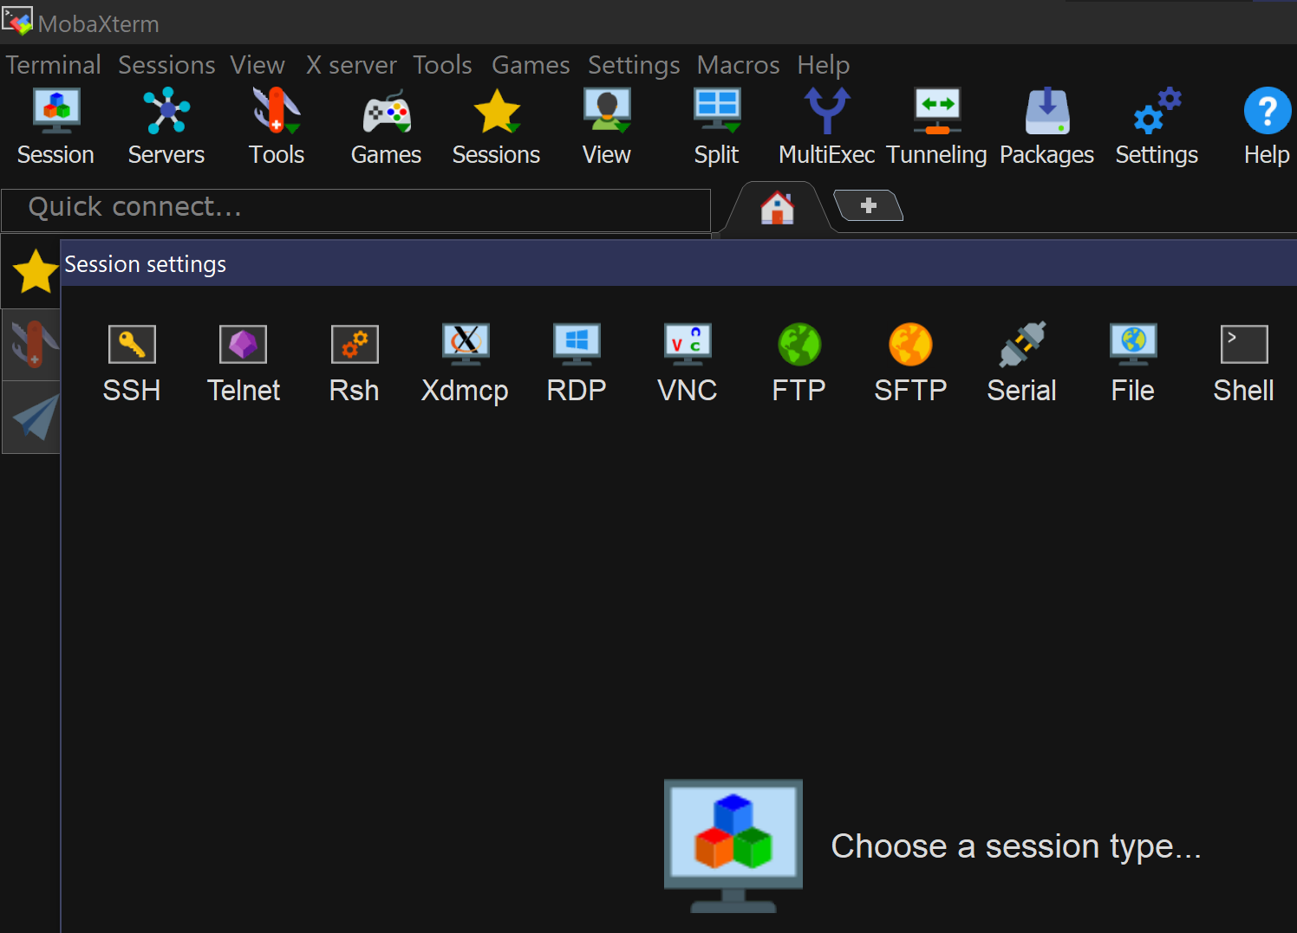
1
2

Slide 4
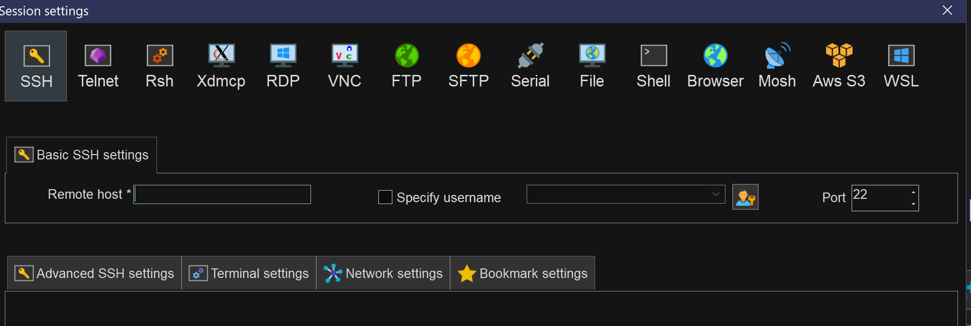
3
4
3 – login.deucalion.macc.fccn.pt
4 – the username

Slide 5
ssh key-pairs
See Start - Deucalion User Guide for help on generating and registering your keys

Slide 6
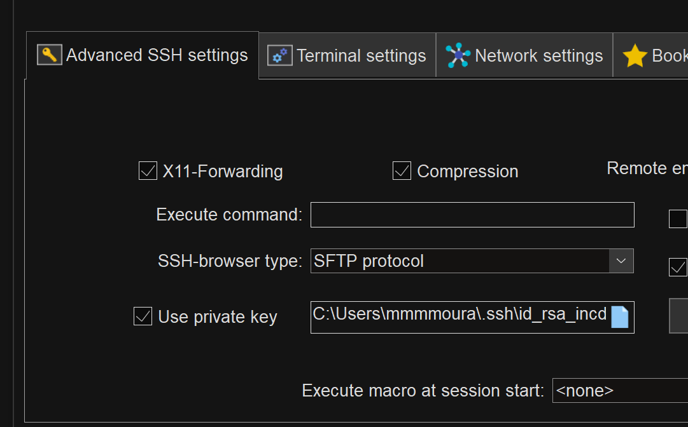
5

Slide 7
Tools
If using a Microsoft Windows OS:
- MobaXTerm Home Edition (available from https://mobaxterm.mobatek.net/)
Alternatives for Windows OS/MacOS:
- Visual Studio Code

Slide 8
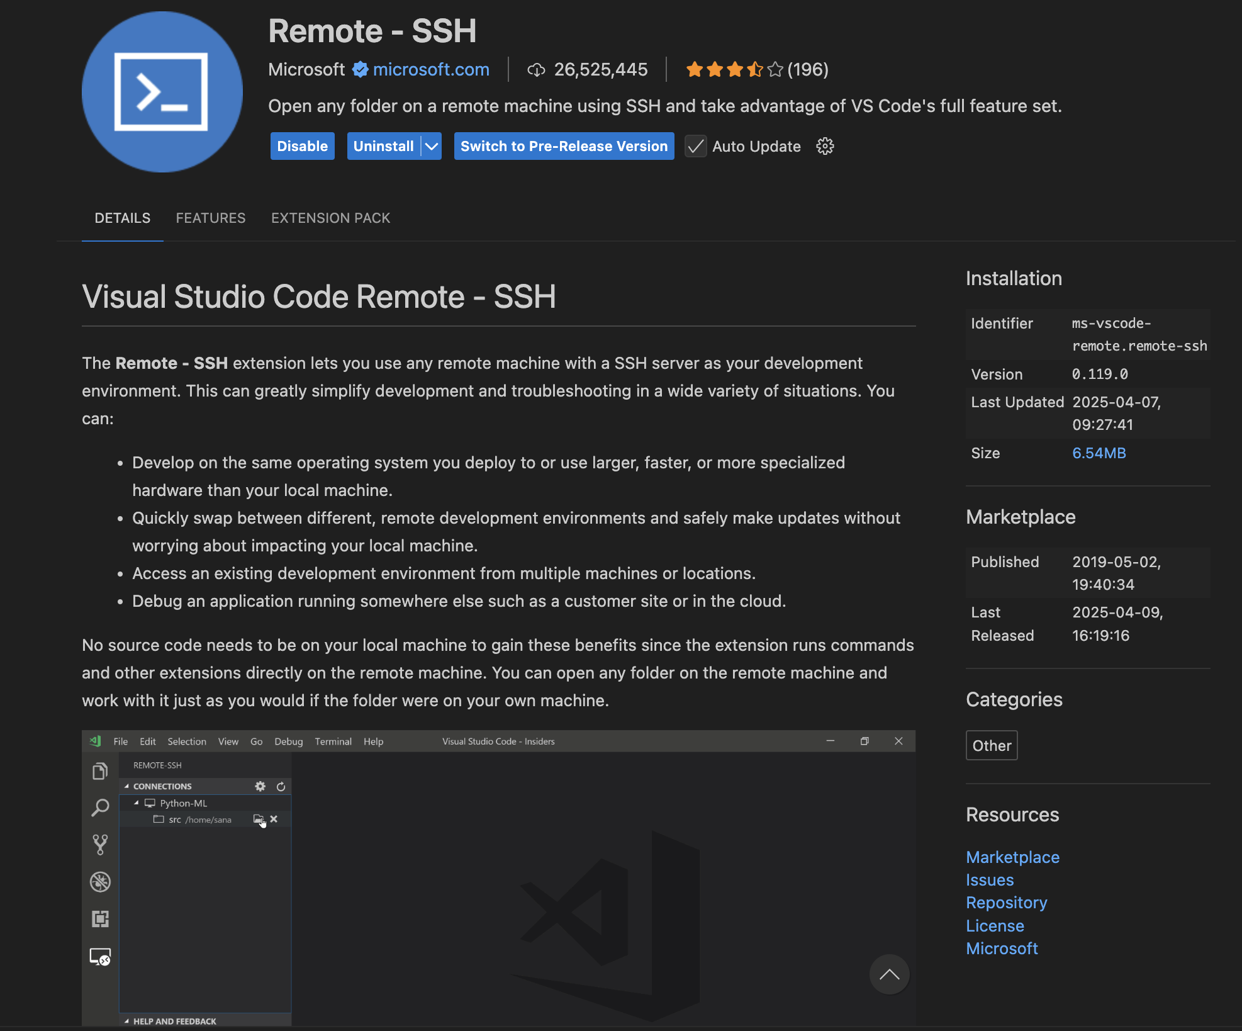
Starting a remote session using VS Code
- Install the following extension if not already installed

Slide 9
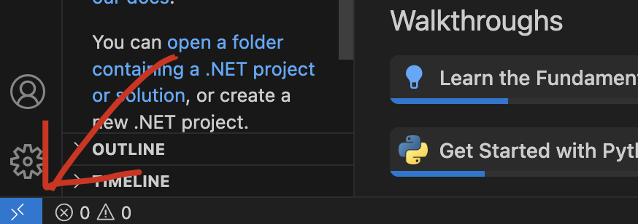
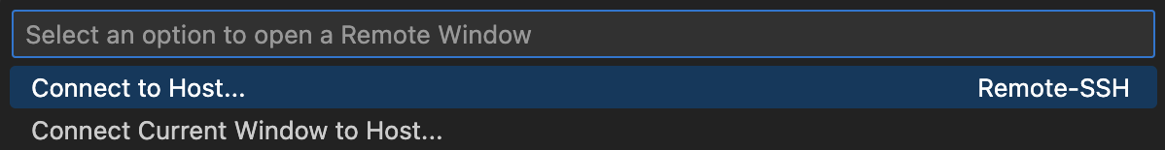
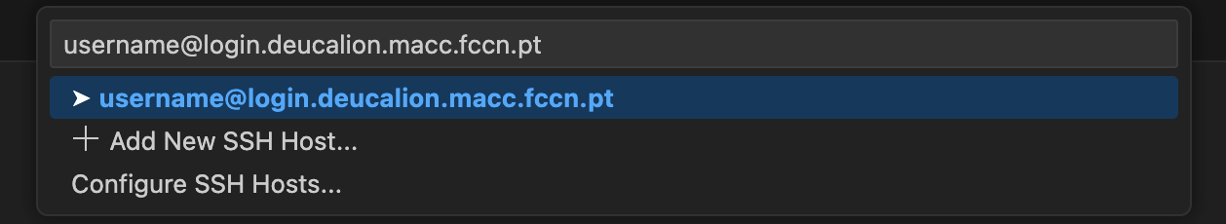
1
2
3

Slide 10
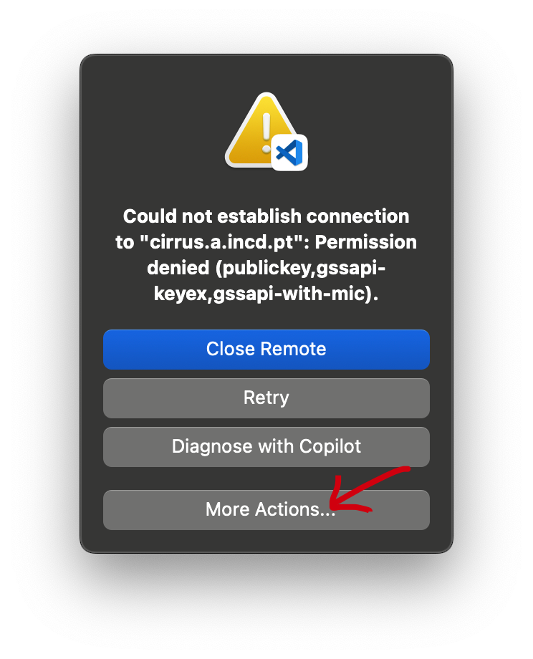
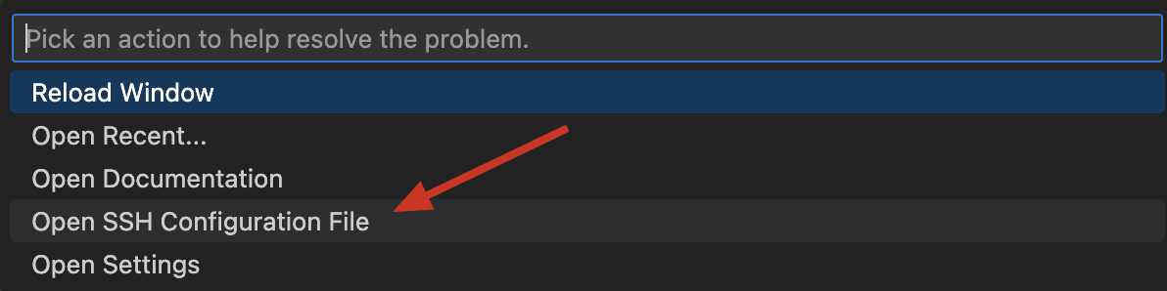
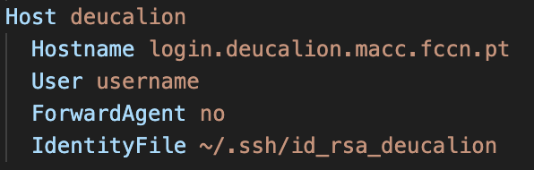
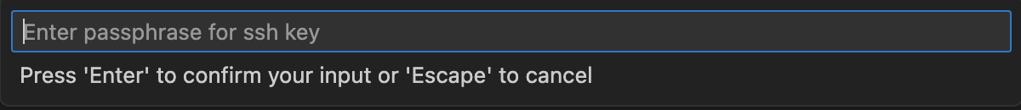
When encountering this error follow these steps:
Make sure your config includes: IdentifyFile ~/Path/To/Private_Key

Slide 11
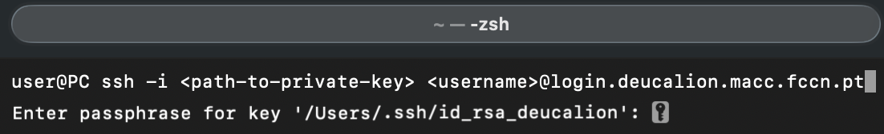
Tools
If using a Microsoft Windows OS:
- MobaXTerm Home Edition (available from https://mobaxterm.mobatek.net/)
Alternatives for Windows OS/MacOS:
- Visual Studio Code
If using the terminal:

Slide 12
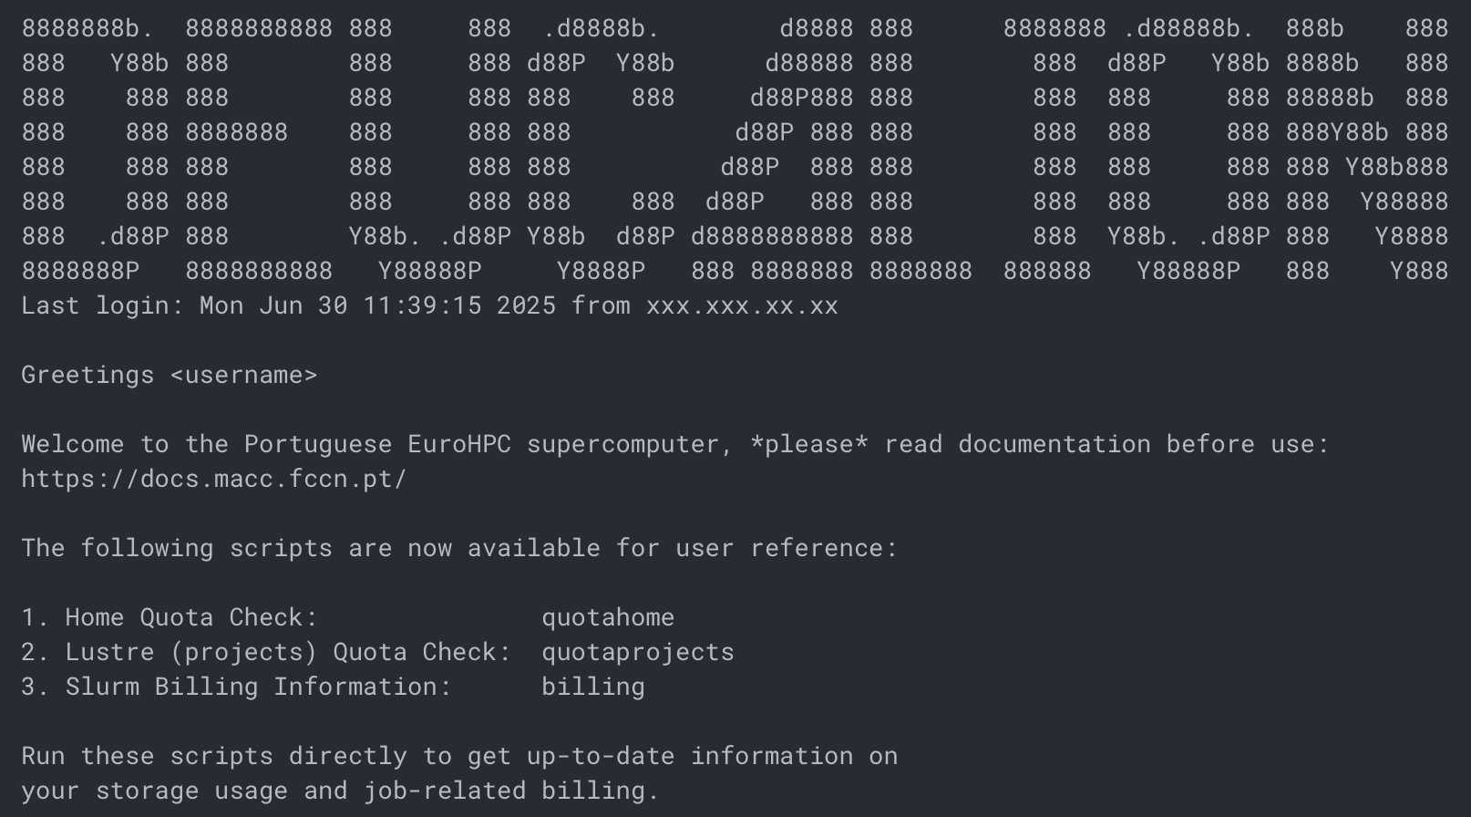
After log in

Slide 13
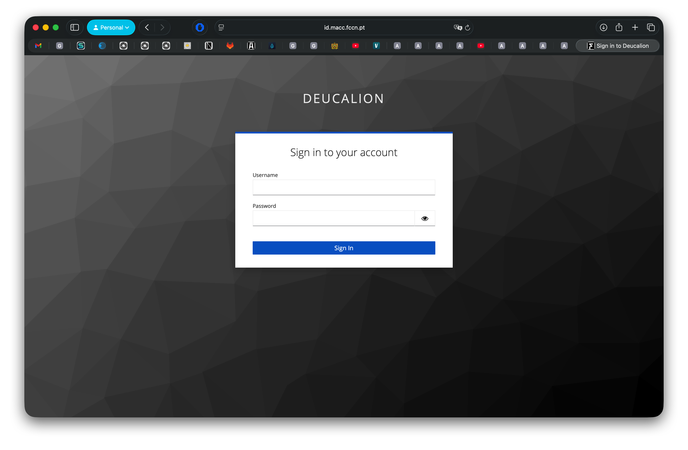
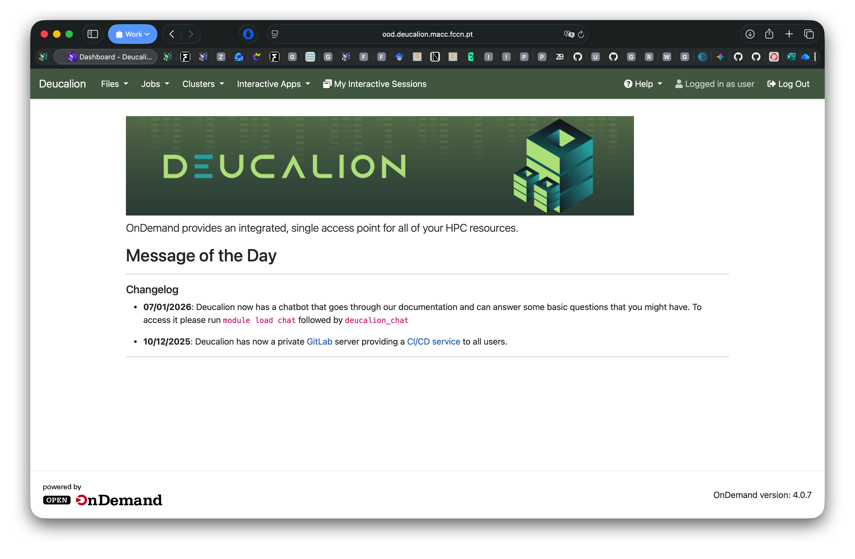
Open On Demand
https://login.deucalion.macc.fccn.pt/

Slide 14
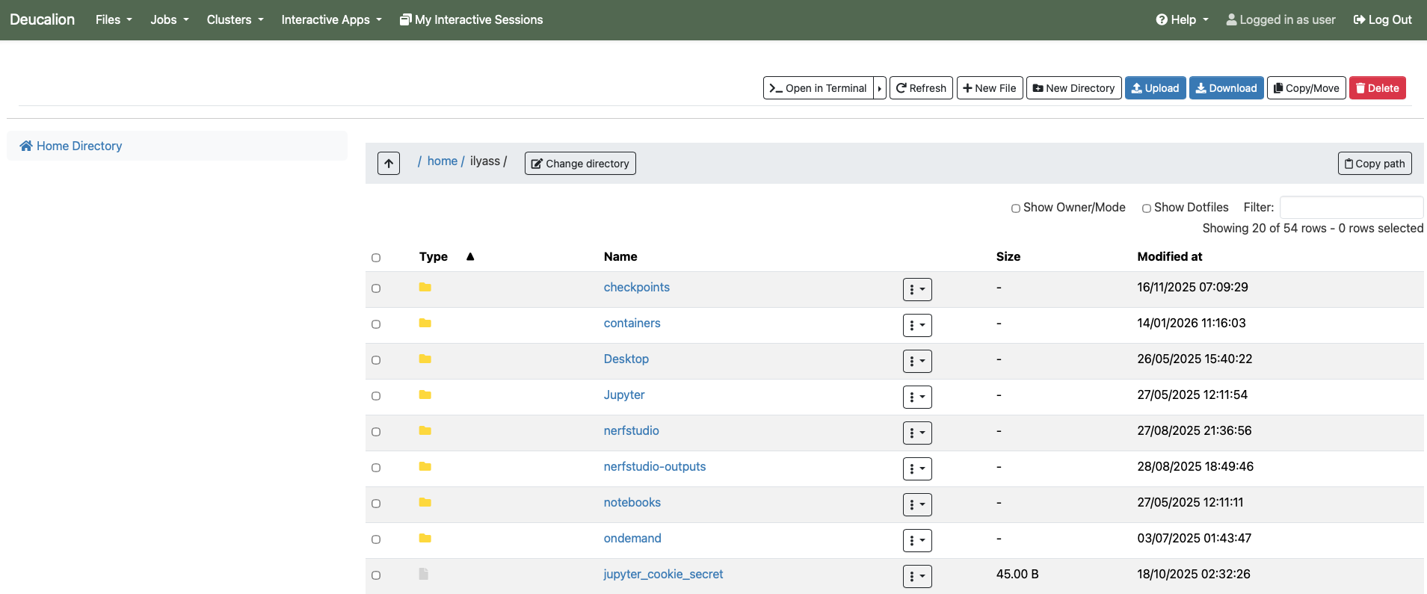
Open On Demand

Slide 15
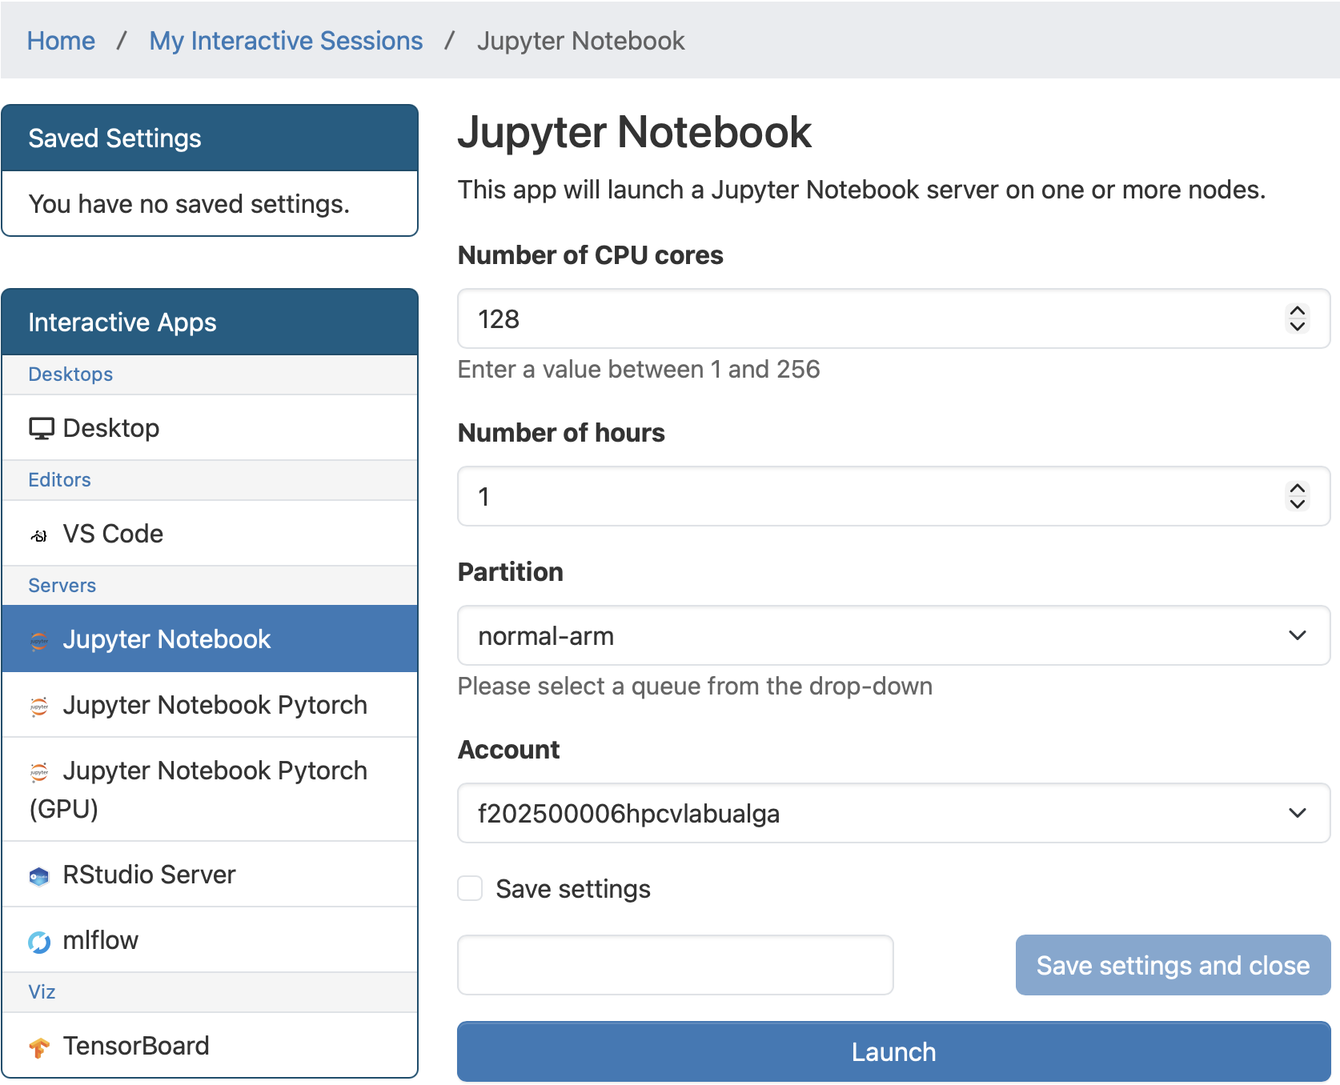
Open On Demand

Slide 16
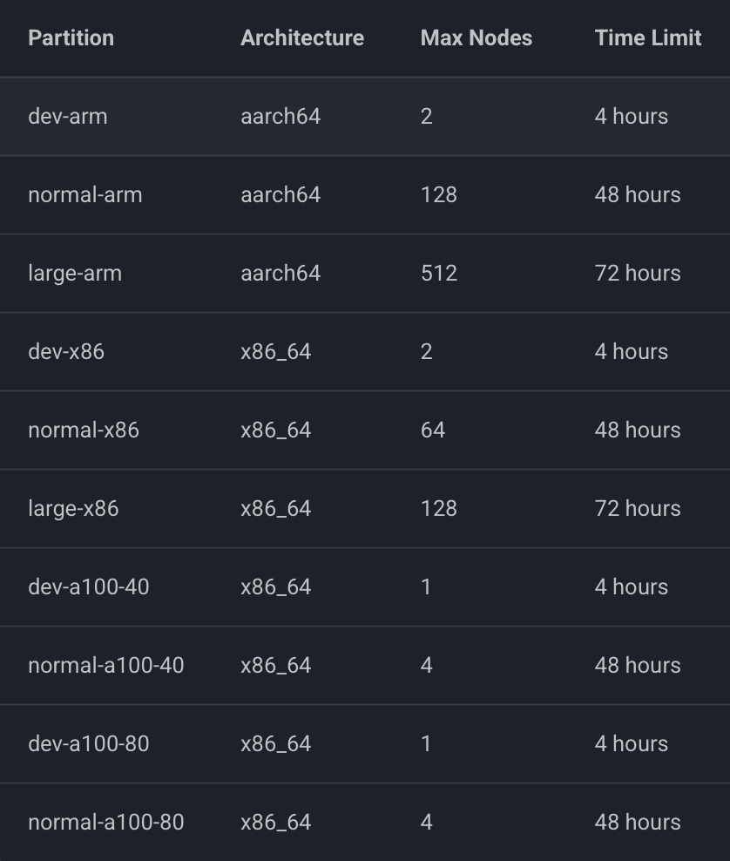
Partitions
Heterogeneous Architecture: Deucalion supports three distinct computing paradigms.
ARM (aarch64): Powered by Fujitsu A64FX processors (High Bandwidth Memory). Ideal for memory-bound applications.
x86 (x86_64): Powered by AMD EPYC processors. Standard general-purpose computing.
Accelerated (A100): Nodes equipped with NVIDIA A100 GPUs (40GB or 80GB VRAM) for AI and MD workloads.

Slide 17
Environment Management
Deucalion uses environment modules to manage compilers (GCC, Intel), MPI versions, Python, etc.
module avail # show available modules
module spider # search for a module
module load [module] # load a module
module list # list all loaded modules
module unload [module] # unload a module
module purge # unload all modules

Slide 18
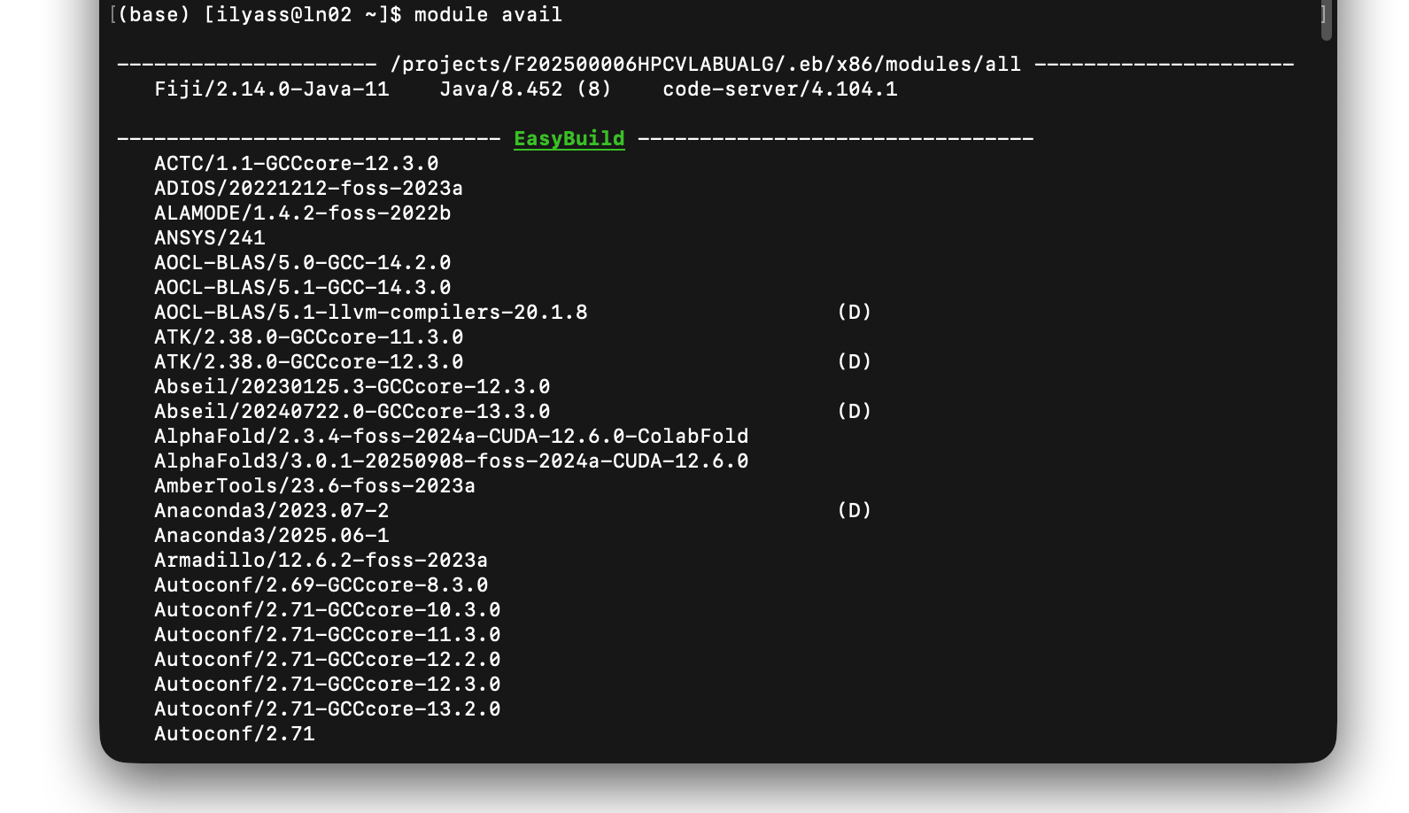
Environment Management
module avail

Slide 19
Environment Management
module avail # show available modules
module spider # search for a module
module load [module] # load a module
module list # list all loaded modules
module unload [module] # unload a module
module purge # unload all modules

Slide 20
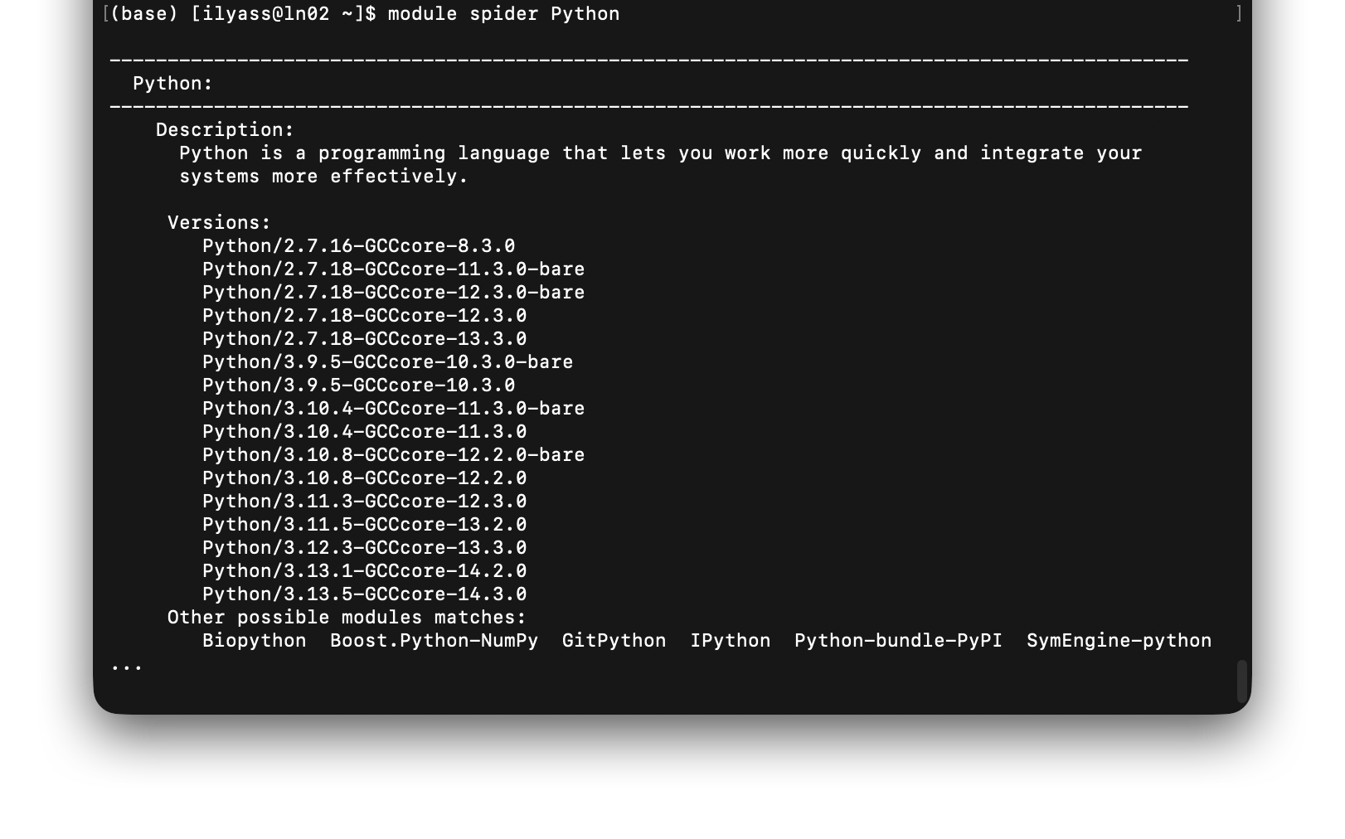
Environment Management
module spider

Slide 21
Environment Management
module avail # show available modules
module spider # search for a module
module load [module] # load a module
module list # list all loaded modules
module unload [module] # unload a module
module purge # unload all modules

Slide 22
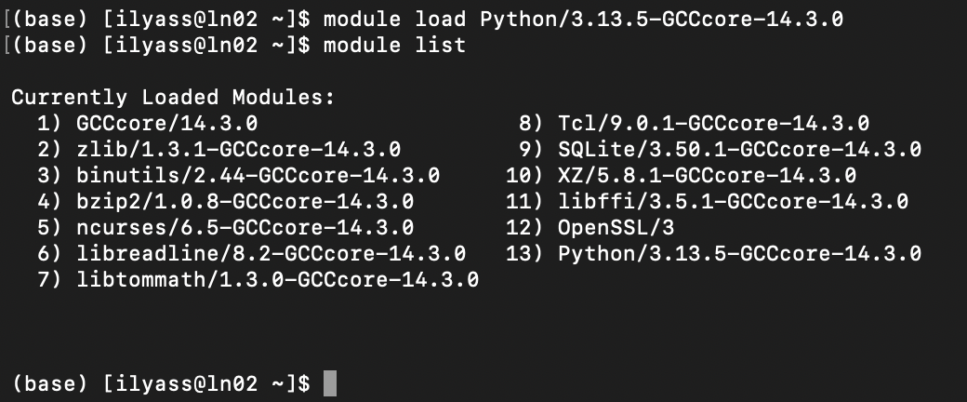
Environment Management
module load + module list

Slide 23
Environment Management
module avail # show available modules
module spider # search for a module
module load [module] # load a module
module list # list all loaded modules
module unload [module] # unload a module
module purge # unload all modules

Slide 24
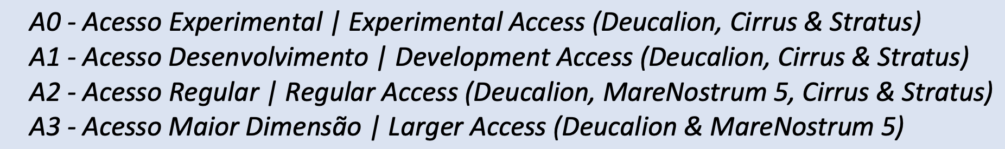
Call Advanced Computing Projects
https://myfct.fct.pt/MyFCT/homepage.aspx
Notes:
A0 – Experimental Access
For: Beginners & First-timers.
Purpose: Experimentation, visualization, and testing the platform.
Review: Technical check only (Fast approval).
Duration: 6 months.
A1 – Development Access
For: Developers & Optimizers.
Purpose: Code optimization, benchmarking, and scalability testing.
Review: Technical check only.
Duration: 3 – 12 months.
A2 – Regular Access
For: Consolidated Scientific Projects.
Purpose: Standard production runs for research/innovation.
Review: Scientific Merit Evaluation + Technical check.
Duration: 12 months.
A3 – Larger Access
For: Massive Scale Projects.
Purpose: Projects requiring high volumes of resources (Deucalion & MareNostrum 5).
Review: Scientific Merit Evaluation + Technical check.
Duration: 12 months.

Slide 25
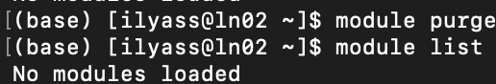
Environment Management
module unload [module] / module purge

Slide 26
Call Advanced Computing Projects
https://myfct.fct.pt/MyFCT/homepage.aspx
Need more power? Apply to EuroHPC for access to European Tier-0 supercomputers (LUMI, Leonardo, etc.).
Industry/Commercial? Computing resources can be purchased directly for private R&D or pre-competitive innovation.

Slide 27
Good practices
“Computing time
The available hours in your project can be seen in the user portal (projects tab in the sidebar) or by running billing in any of the login nodes. To check the disk quota in all your projects you can run quotaprojects. To get the quota information of your home you can run quotahome. These commands are also present at login time.
Node exclusivity
In Deucalion all nodes are exclusive (apart from the ooda partition and the GPU partitions). This means that if you only request one core from a CPU machine you will still get billed the whole 48/128 (ARM/x86, respectively). In the GPU nodes resources are shared (unless you set #SBATCH --exclusive in your batch script).”
From the Deucalion documentation

Slide 28
Good practices
“User storage
The users have a quota of 25GB and 25000 files in their /home directory, they are NOT allowed to use more storage.
The users MUST run jobs only in /projects/$project, $project represents the project respective name.
”
From the Deucalion documentation

Slide 29
Good practices
Working area
Create an area (my_working_dir) for your projects in /projects/F202500006HPCVLABUALG/
To make it easier, do: echo "export PROJECT=/projects/F202500006HPCVLABUALG" >> .bashrc
And from that moment onwards, do
$ cd $PROJECT/<my_working_dir>

Slide 30
Good practices
Do not run jobs on the login nodes. If you need to try a small exemple, use salloc or srun
Look for Interactive Slurm jobs (Overview - Deucalion User Guide)

Slide 31
The “Small Files” Trap
The Standard Way: We use module load for system tools (Compilers, MPI). It’s great.
The Problem: For Python, we tend to create virtual environments.
The Bottleneck:
A simple environment creates thousands of tiny files.
Deucalion uses Lustre (Parallel File System).
Lustre is optimized for large files, not thousands of tiny ones.
Result: Slow loading times, stressed metadata servers, and “angry sysadmins”.

Slide 32
The “Small Files” Trap
Best Practice: Encapsulate your environment into a single .sif file.
Why?
1 Environment = 1 File.
Performance: Near Instant startup.
Portability: Move it anywhere.
The "Fakeroot" Hurdle:
To build a container (install packages inside it), you need root permissions.
On HPC, we use --fakeroot (simulated root) to build images safely.
Note: You will need to request this permission or build on your own machine and upload.

Slide 33
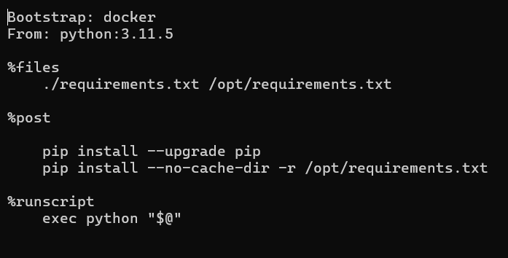
Singularity
Step 1
Create a Definition File (my_recipe.def)

Slide 34
Singularity
Step 2
Create the container

Slide 35
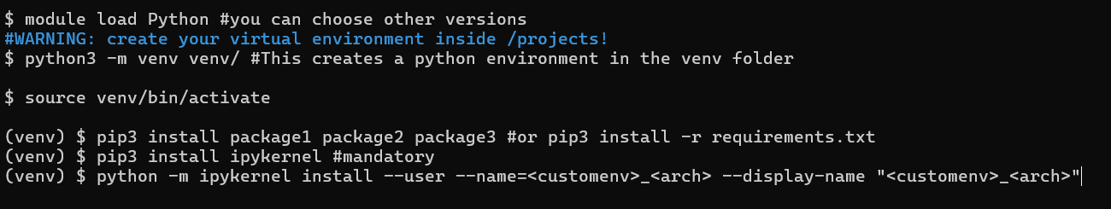
Connect to Jupyter
Challenge: Open OnDemand doesn't know about your .sif file automatically.
Solution: Create a Custom Kernel.
Run this ONCE inside the terminal:
Outcome: "customenv" now appears in the Jupyter Dropdown menu.

Slide 36
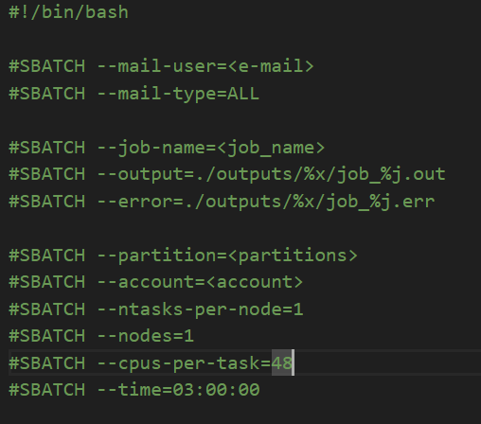
SLURM Jobs
Interactive Jobs (Foreground):
Command: salloc or srun --pty ... /bin/bash
Best for: Testing scripts in the terminal before scaling up.
Batch Jobs (Background):
Command: sbatch script.sh
Best for: Production runs, long trainings, heavy BLAST jobs.

Slide 37
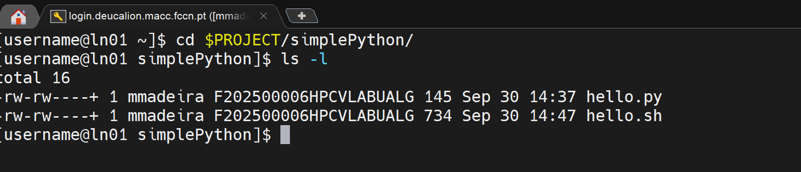
Hello python
Copy hello.py and hello.sh into your project directory Examine hello.sh and change as appropriate
Run:
$ sbatch hello.sh
and examine the .out and .err files

Slide 38
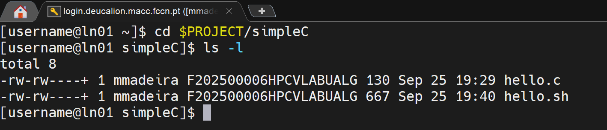
Hello C
Copy hello.c and hello.sh into your project directory Examine hello.sh and change as appropriate
Run:
$ sbatch hello.sh
and examine the .out and .err files

Slide 39
References
Software used in the presentation:
mobaxterm, vscode
Deucalion User Guide:
https://docs.macc.fccn.pt/
HPCVlab – GitHub:

Slide 40
Acknowledgements This initiative is supported by the project “NATIONAL COMPETENCE CENTRES IN THE FRAMEWORK OF EUROHPC PHASE 2 – EUROCC2”, funded by Fundação para a Ciência e Tecnologia, I.P., and “DIGITAL-EUROHPC-JU-2022-NCC-01” of the European High-Performance Computing Joint Undertaking ('JU’) and makes use of Deucalion supercomputer of CNCA - National Distributed Computing Infrastructure.

